Slide 1
02 Dynamic Programming + Monte Carlo method

Slide 2

This tutorial is mainly contributed by…
Github
方泽鸣，zemingfang11@gmail.com
张洳源，ruyuanzhang@gmail.com
张洁莹，jieying.zhang@student.uva.nl
部分内容由张洳源老师正在编写的教材《认知行为的计算原理》收录： https://ruyuanzhang.gitbook.io/compmodcogpsy

Slide 3
Recap
Lecture
Markov Decision Process (MDP)
State, action, reward, transition
Decision-making on MDP
Goal, value, poilcy, Q value
Value evaluation
Bellman equation
Policy evaluation
Practice Policy evaluaton

Slide 4
Overview
Lecture
Policy iteration
Value iteration
Monte Carlo Methods
Practice Policy iteration
Value iteration
Monte Carlo Methods

Slide 5
Definition:
Goal:
Model-based
Model-free
A lack of model
Dynamic Programming
Monte Carlo Method
Policy iteration
Value iteration

Slide 6
Overview
Lecture
Policy iteration
Value iteration
Monte Carlo Methods
Practice
Policy iteration
Value iteration
Monte Carlo Methods

Slide 7
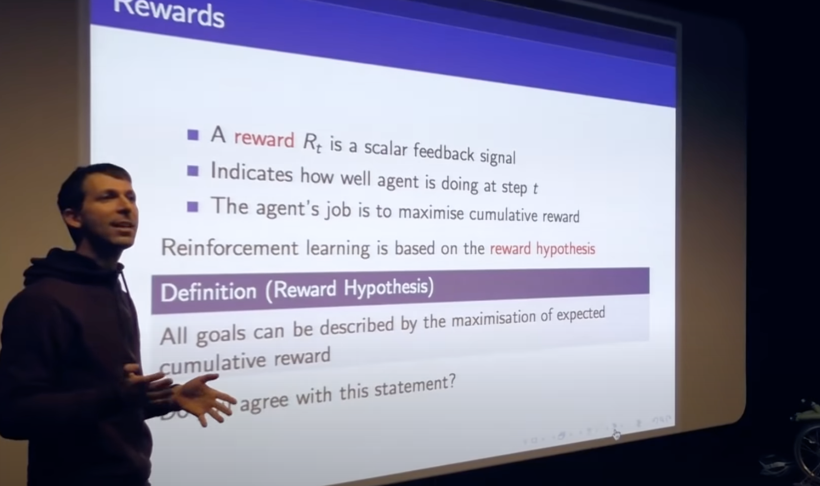
Goal: reward hypothesis

Slide 8
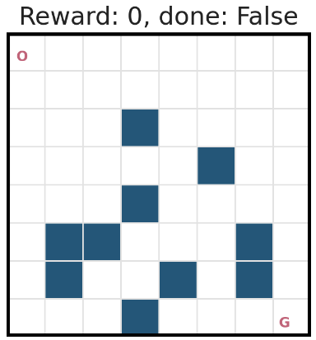
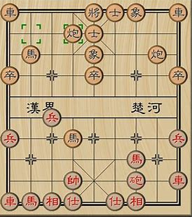
Value evaluation is not easy
要不要读博？
o

Slide 9
Why does value evaluation require a policy as input?

Slide 10
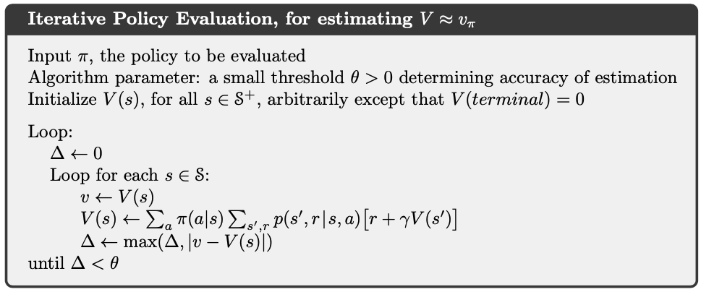

Poicy evaluation

Slide 11
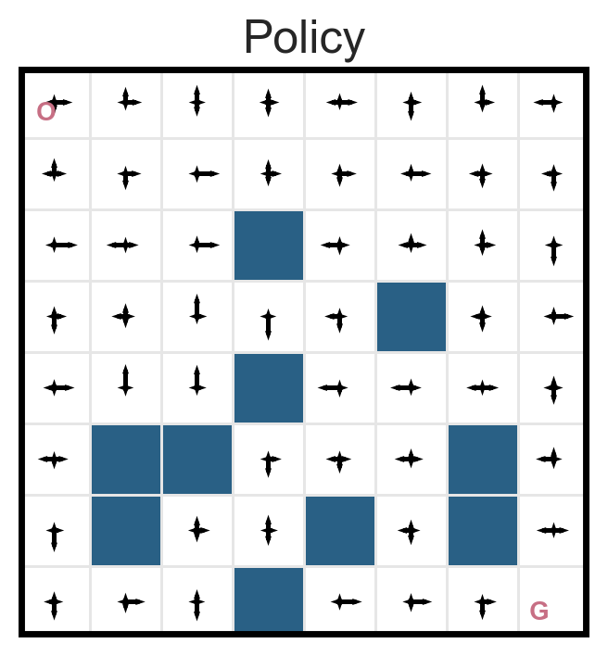
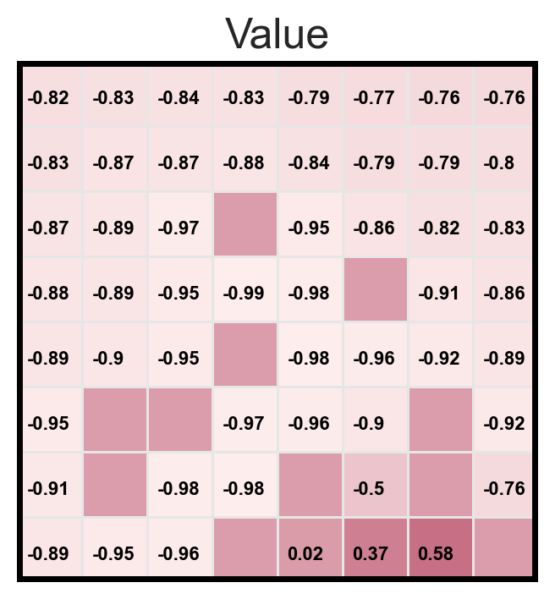
Policy evaluation results
BAD POLICY

Slide 12
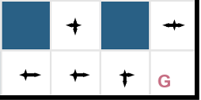
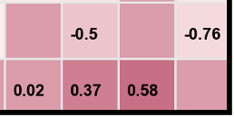
Policy improvement: greedy policy

Slide 13
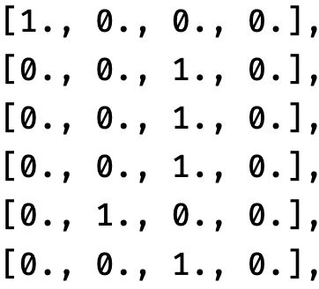
Policy improvement: greedy policy

Slide 14

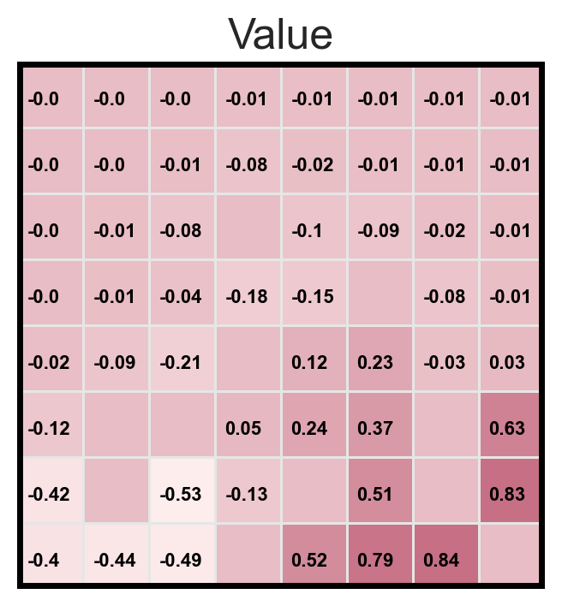
Policy improvement: greedy policy

Slide 15
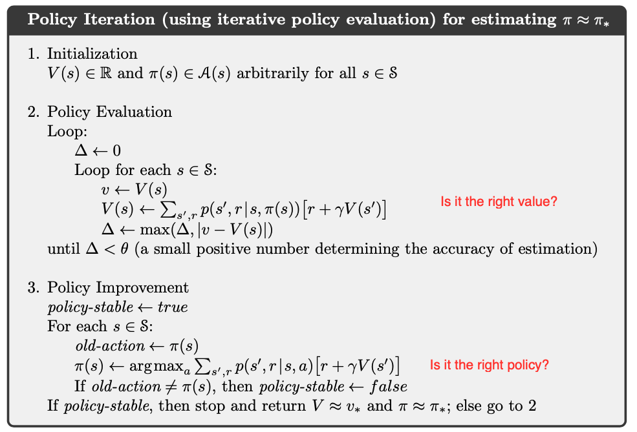
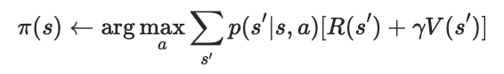
#Practice: Policy iteration

Slide 16
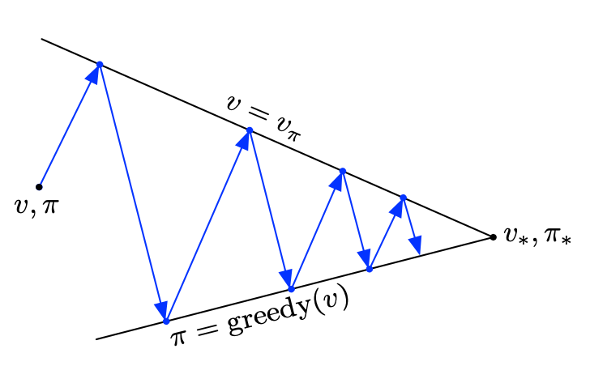
Policy iteration
Policy evaluation
Policy improvement
Policy evaluation
Policy improvement
(Sutton & Barto, 2018)

Slide 17
Overview
Lecture
Policy iteration
Value iteration
Monte Carlo Methods
Practice
Policy iteration
Value iteration
Monte Carlo Methods

Slide 18
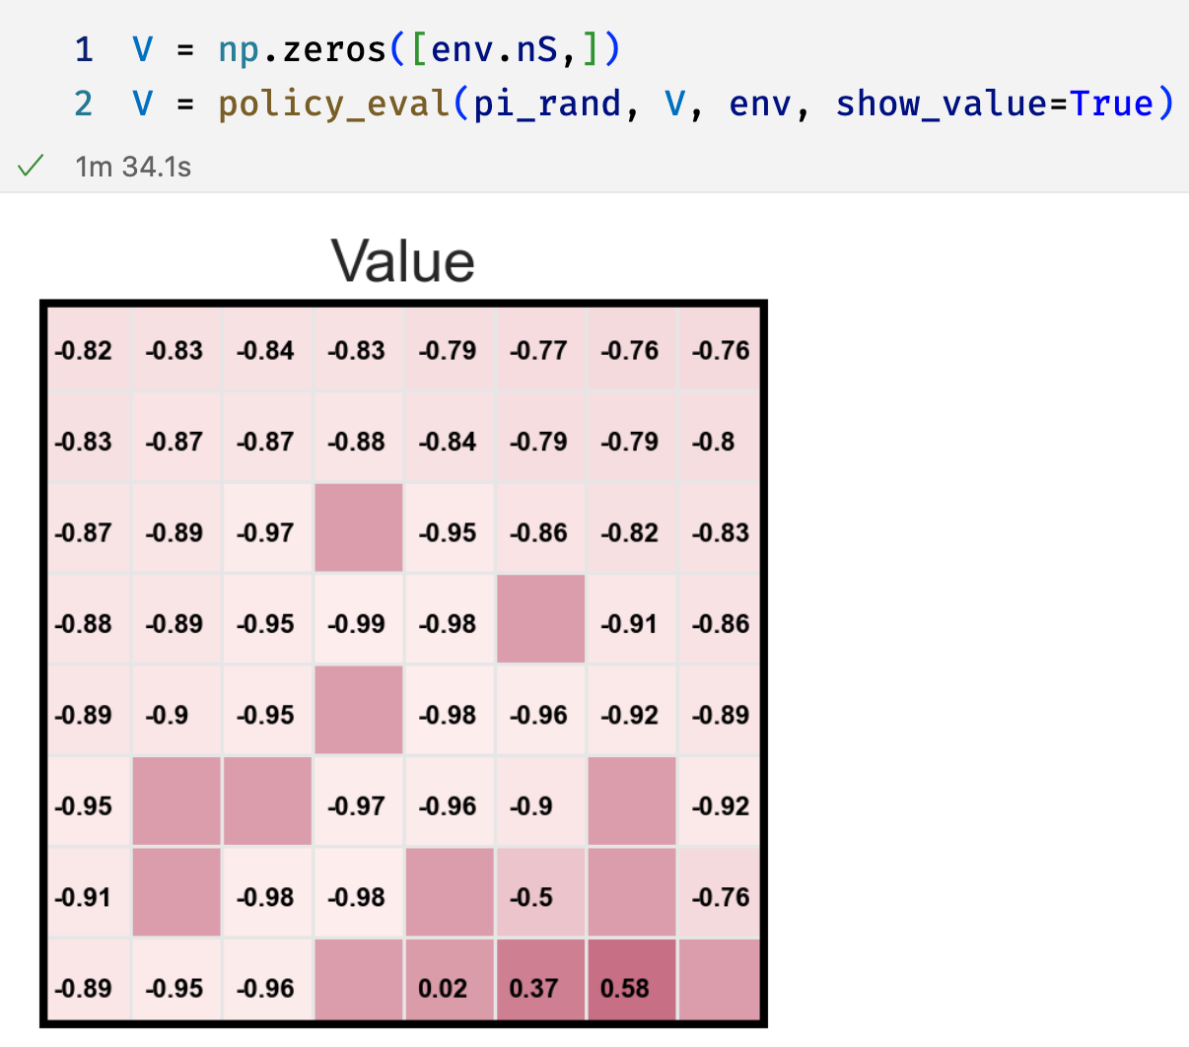
One drawback of policy iteration

Slide 19
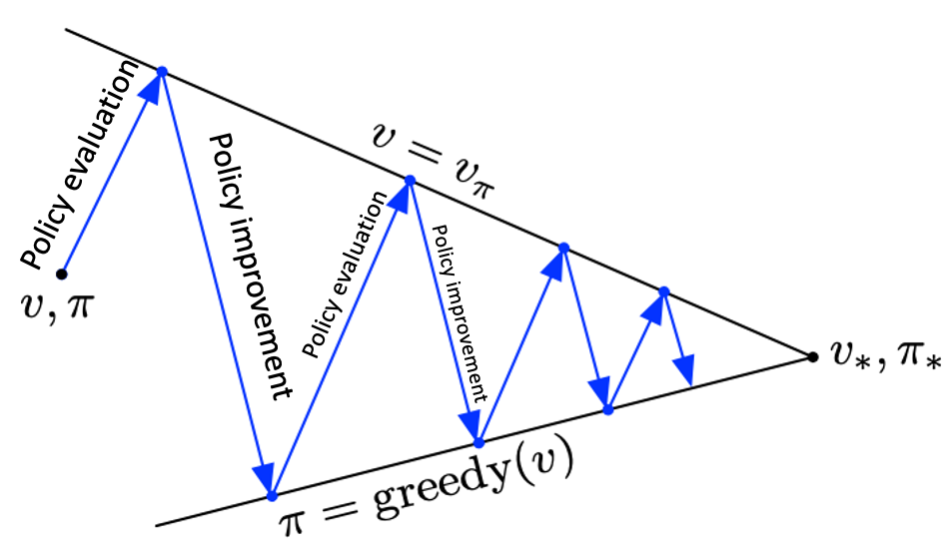
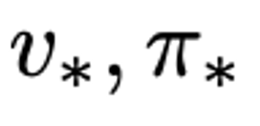
Value iteration
Policy Iteration
Value Iteration

Slide 20
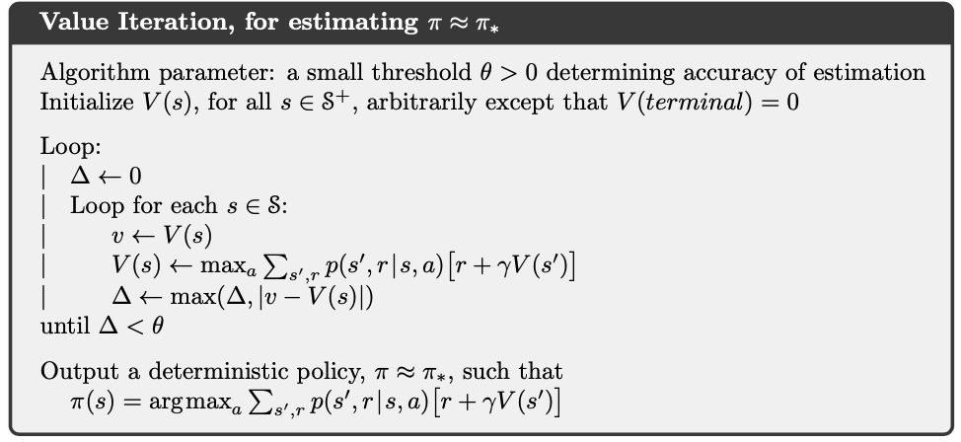
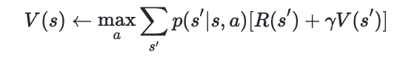
Value iteration

Slide 21
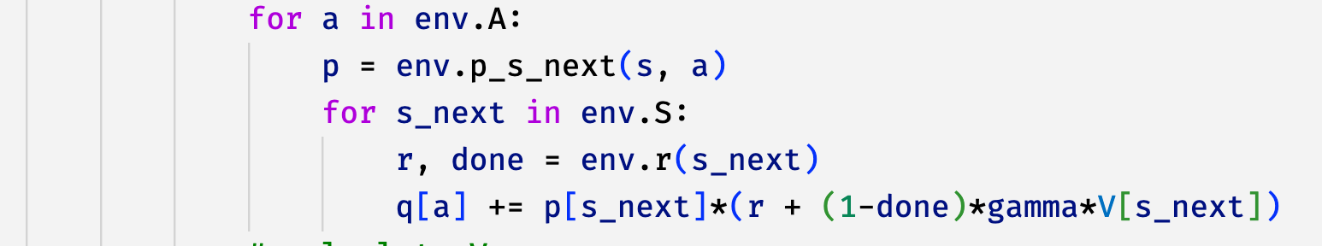
#Practice: Value iteration
Trial and error

Slide 22
Overview
Lecture
Policy iteration
Value iteration
Monte Carlo Methods
Practice
Policy iteration
Value iteration
Monte Carlo Methods

Slide 23
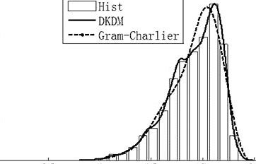
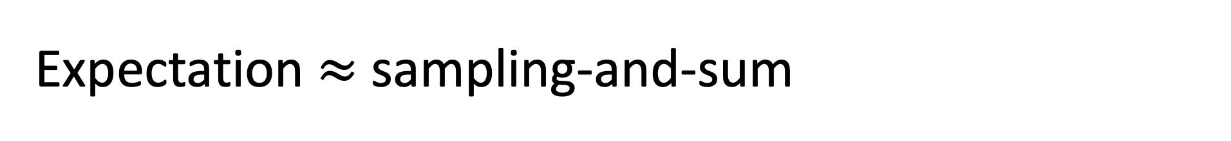
Expectation $≈$ sampling-and-sum

Slide 24
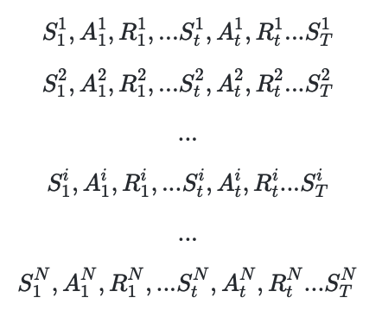
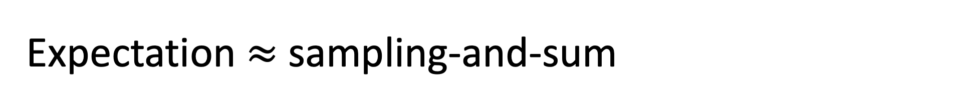
Expectation $≈$ sampling-and-sum

Slide 25
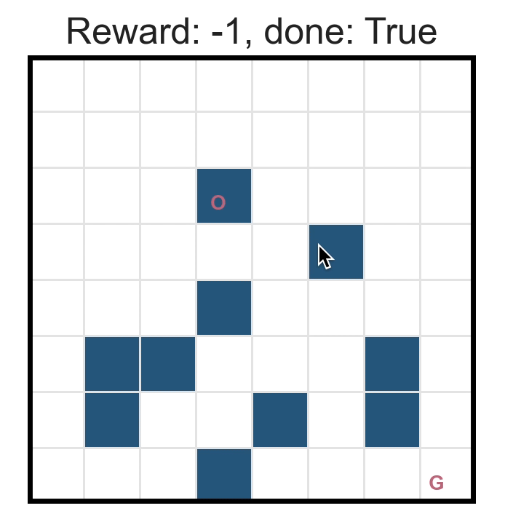
#Practice: rollout

Slide 26
Expectation $≈$ sampling-and-sum

Slide 27
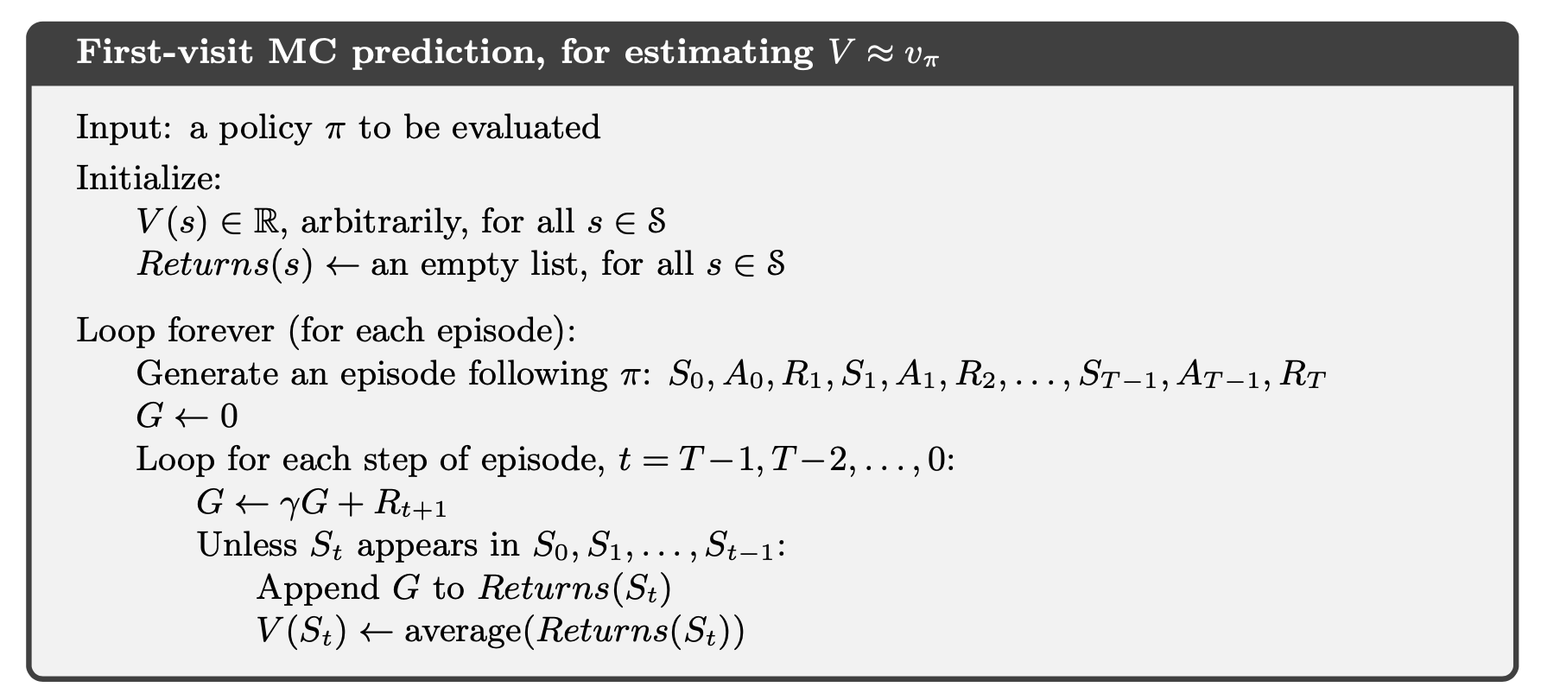
#Practice: Monte Carlo Method
Unknow environmental transition

Slide 28
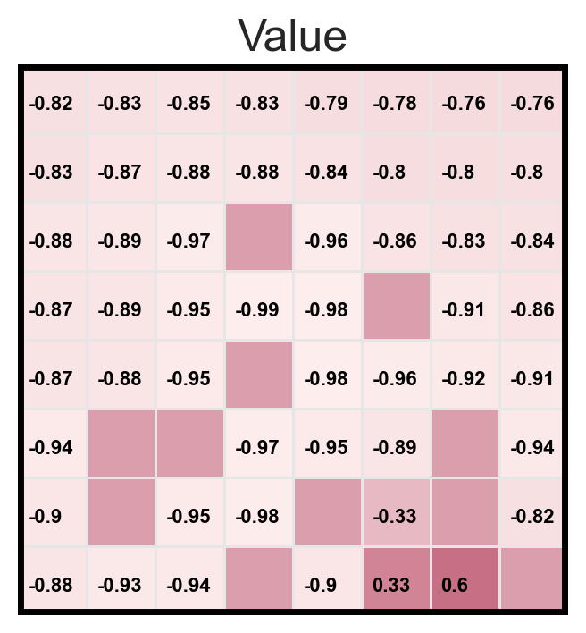
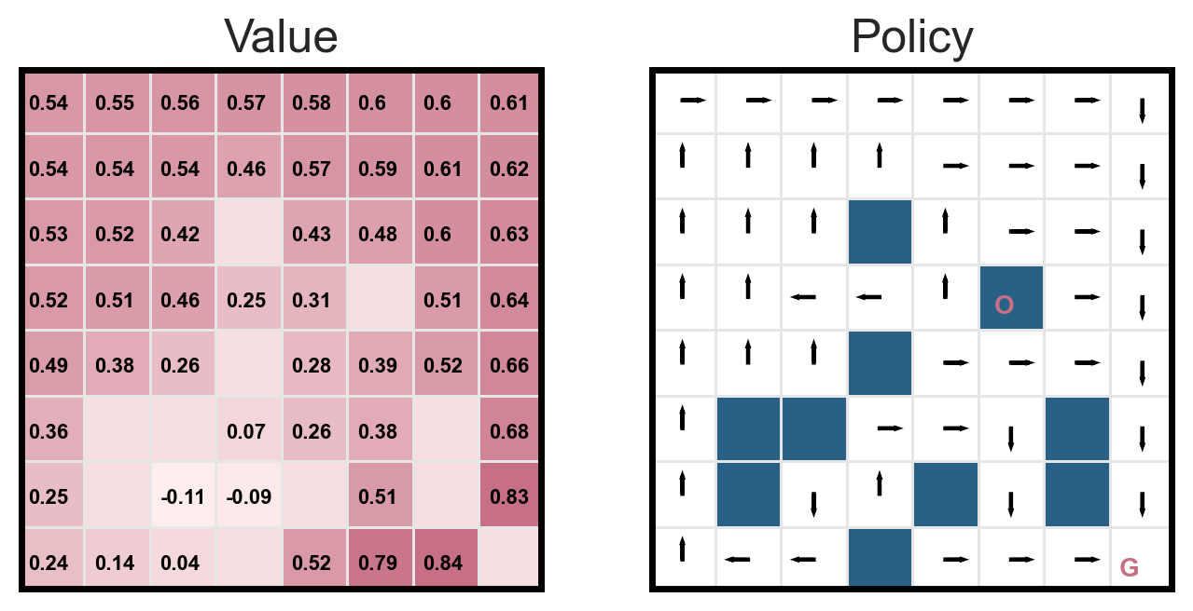
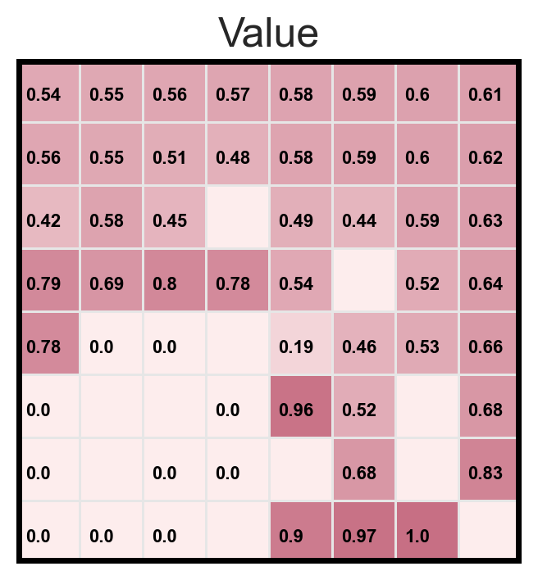
Policy evaluation vs. MC prediction
Policy evaluation
MC prediction
Random policy
Optimal policy
Exploration and exploitation

Slide 29
Definition:
Goal:
Model-based
Model-free
A lack of model
Dynamic Programming
Monte Carlo Method
Policy iteration
Value iteration
How do humans learn?

Slide 30
Overview
Lecture
Policy iteration
Value iteration
Monte Carlo Methods
Practice Policy iteration
Value iteration
Monte Carlo Methods

